Slide 1
ECE 5706: Resilient Computer System Design
Resilient Hardware Design – Device-Level
Xin Xin
Assistant Professor
Electrical and Computer Engineering
ACKNOWLEDGEMENT:
Prof. Behrooz Parhami at UCSB
Prof. Ronald F. DeMara at UCF
Notes:
<number>

Slide 2

1 Defect Avoidance
Slide <number>
Notes:
<number>
Defect in a piece of rail, exposed after cutting it.

Slide 3
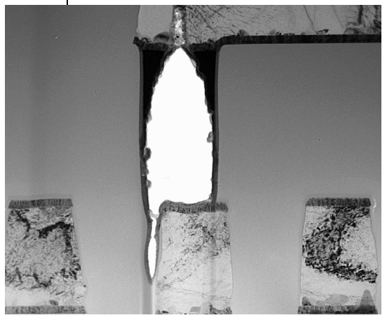
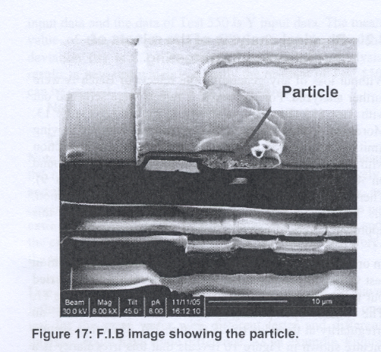
1.1 Types and Causes of Defects
Resistive open due to unfilled via [R. Madge et al., IEEE D&T, 2003]
Particle embedded between layers
Slide <number>
Notes:
<number>

Slide 4
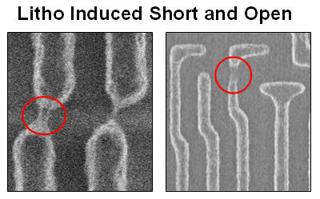
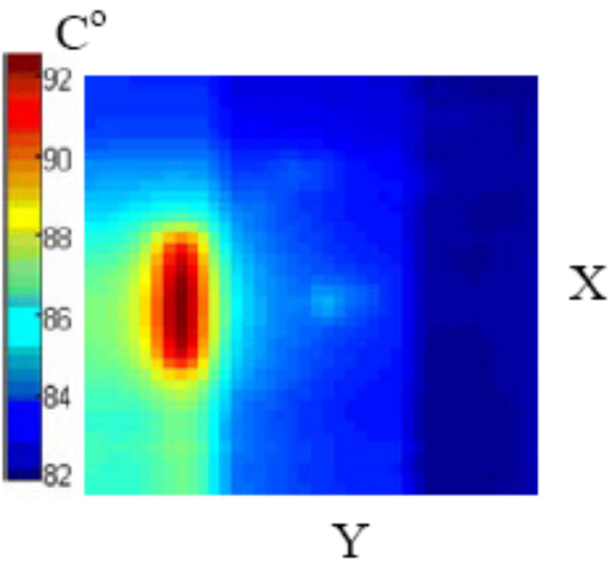
Process and Operational Variations
Even if there isn’t a complete short or open, resistance and capacitance variations can lead to trouble
Chip temperature map
Slide <number>
Notes:
<number>

Slide 5
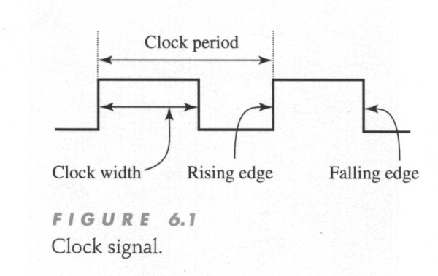
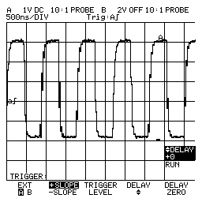
Analogy: Ideal vs. Real Clock Signals
Ideal clock signal has sharp edges and an exact constant period
Real clock signal is quite different
Slide <number>
Notes:
<number>

Slide 6
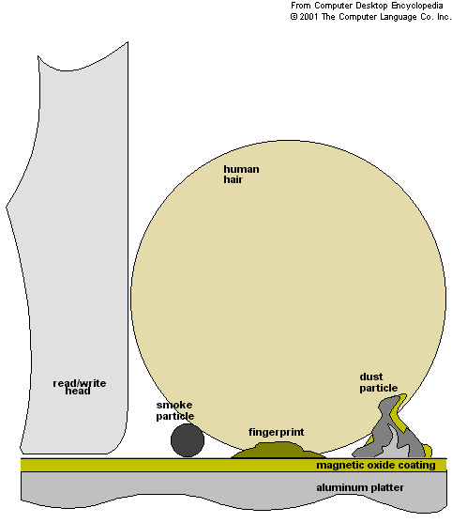

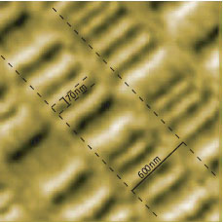
Disk Memory Defects
The tiniest particle or scratch can wipe out many thousands of bits
Slide <number>
Notes:
<number>

Slide 7
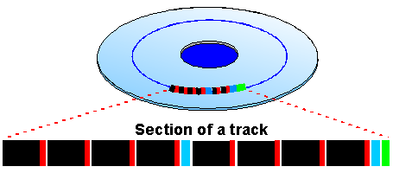
Protective Error Coding in Disk Memories
Disks typically use CRC or similarly strong error-correcting codes
It is virtually impossible for data to become contaminated
When a sector repeatedly violates the code, it is assumed to be bad
Bad sectors reduce the disk’s capacity
Disk crashes and other catastrophic failures are a different story
Black: Sector data
Red: Sector code
Blue: Block code
Green: Super-block code
Image credit:
Hitachi
Slide <number>
Notes:
<number>

Slide 8
Learning from Failed Disk Drives
Analyses of failed disk drives have led to the following monitoring suggestions to predict when a disk drive is about to go, thus allowing a preemptive replacement before a hard failure
Head flying height: Downward trend often precedes a head crash
Number of remapped sectors: A bad sector is remapped to a different physical location on disk to avoid repeat errors, so having too many remapped sectors signal persistent problems
Frequency of error correction via the built-in code: Disks routinely use CRC and other coding schemes to protect against data loss, but as errors accumulate, they may go beyond the code’s tolerance limit
The following are signs of mechanical or electrical problems:
- Changes in spin-up time
- Rising temperatures in the unit
- Reduction in data throughput
Slide <number>
Notes:
<number>

Slide 9

Solution?
Failure
Spare Component
e.g., the spare component combines the four data components using an XOR operation.
Recovering
Slide <number>
Notes:
<number>

Slide 10
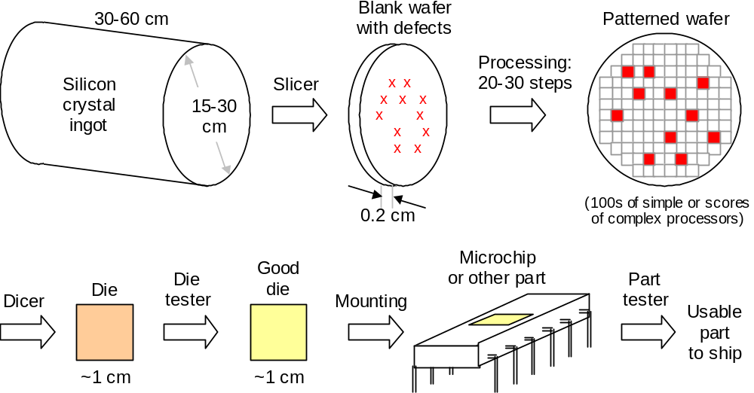
1.2 Yield and Its Associated Costs
Slide <number>
Notes:
<number>
Ciciani, B., Manufacturing Yield Evaluation of VLSI/WSI Systems, IEEE Computer Society Press, 1995.

Slide 11
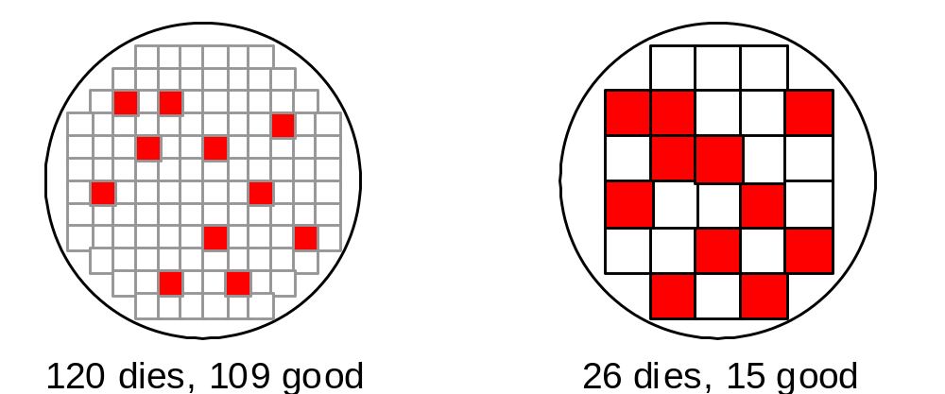
Effect of Die Size on Yield
Shown are some random defects; there are also
bulk or clustered defects that affect a large region
The dramatic decrease in yield with larger dies
Die yield =_{def} (Number of good dies) / (Total number of dies)
Die yield = Wafer yield × [1 + (Defect density × Die area) / a]^{–a}
Die cost = (Cost of wafer) / (Total number of dies × Die yield)
= (Cost of wafer) × (Die area / Wafer area) / (Die yield)
The parameter a ranges from 3 to 4 for modern CMOS processes
Slide <number>
Notes:
<number>
Note that the product of defect density and die area is the expected number d of defects per die. If this expected number is very small, then, (1 + d/a)^(–a) =approx 1/(1 + d) =approx 1 – d. So, if we expect an average of 0.01 defects per die, say, the yield will be 0.99. For larger values of d, however, nonlinearity kicks in and yield is substantially reduced.

Slide 12
Effects of Yield on Testing and Part Reliability
Assume a die yield of 50%
Out of 2,000,000 dies manufactured, ≈1,000,000 are defective
To achieve the goal of 100 defects per million (DPM) in parts shipped, we must catch 999,900 of the 1,000,000 defective parts
Therefore, we need a test coverage of 99.99%
Testing is imperfect: missed defects/faults (coverage), false positives
Going from a coverage of 99.9% to 99.99% involves a significant investment in test development and application times
False positives are not a source of difficulty in this context
Discarding another 1-2% due to false positives in testing does not change the scale of the loss
Slide <number>
Notes:
<number>

Slide 13
1.3 Defect Modeling
Defect are of two main types:
Global or gross-area defects are due to:
Scratches (e.g., from wafer mishandling)
Mask misalignment
over- and under-etching
Can be
eliminated
or minimized
Local or spot defects are due to:
Imperfect process (e.g., extra or missing material)
Effects of airborne particles
Harder
to deal with
Not every spot defect leads to structural or parametric damage
Actual damage depends on location and size (relative to feature size)
Slide <number>
Notes:
<number>
<number>

Slide 14
Example
Systematic Defects
  Process Variation
  Can be characterized (predictable)
Random Defects
  Cell-level Defect
  Often unpredictable
Hints?
  AI models can be trained based on characterized systematic defects.
  AI models are often tolerant to small, light errors
Randomly occurred errors
Weak / unhealthy blocks due to process variation
Slide <number>
Notes:
<number>
<number>

Slide 15
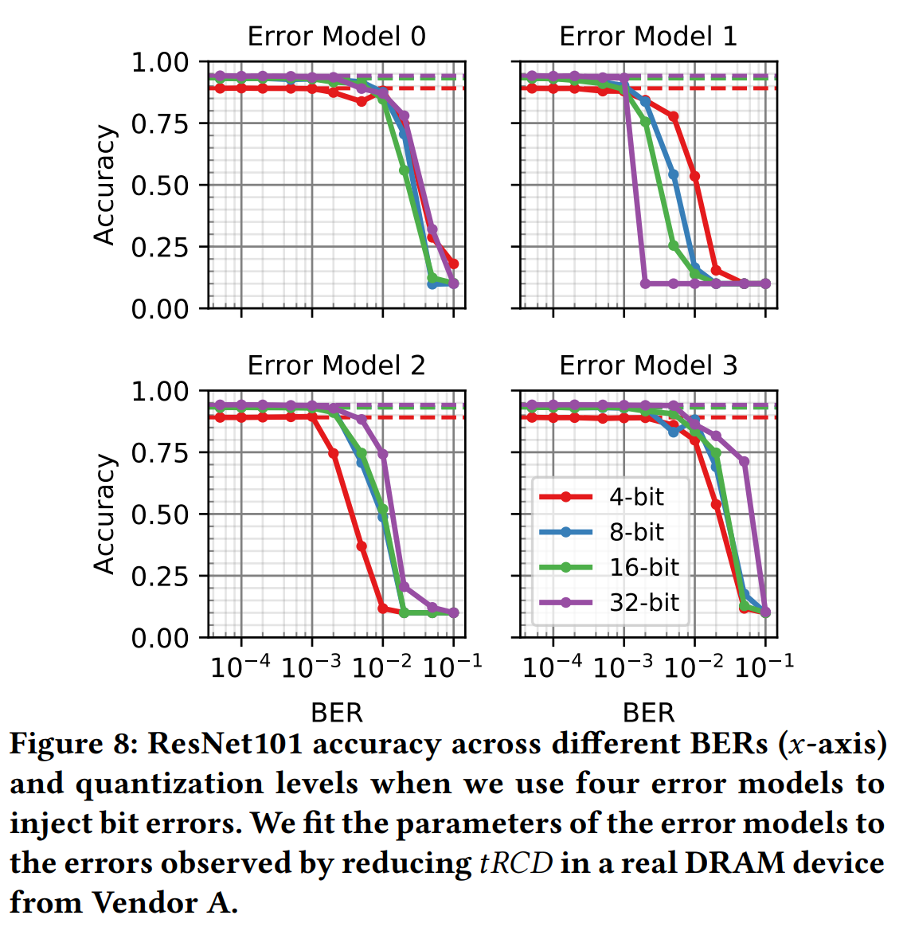
Is DRAM Reliability a Big Problem in the AI era?
Fault Tolerance in AI Models
  Intrinsic Tolerance to Numerical Approximation
  Only a Small Fraction of Bits Are Highly Critical
  Quantization Can Further Improve Error Resilience
Commodity DRAM Already Has a Very Low Error Rate
  << 10⁻⁶
Skanda Koppula, et al, EDEN, MICRO 2019
Slide <number>

Slide 16
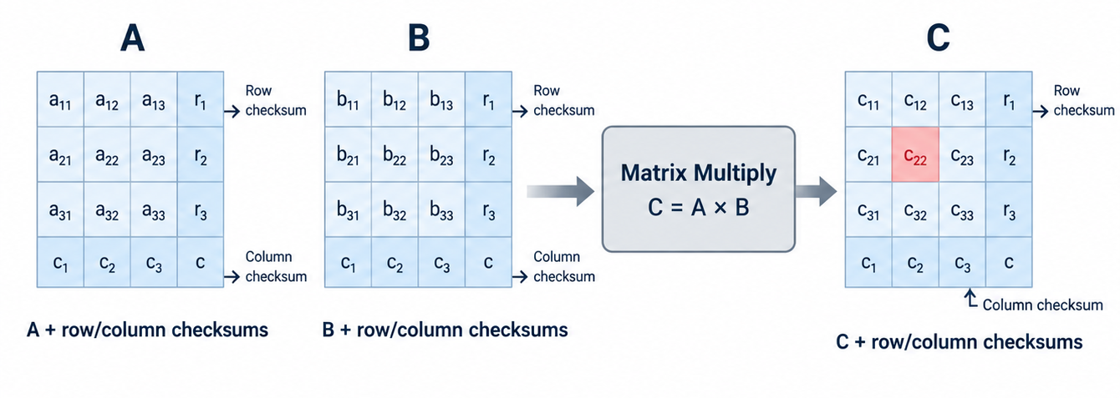
Covered by More Effective System-Level Approaches
System-level reliability mechanisms may already provide sufficient protection against DRAM errors.
Checkpoint
Statistical protection
  Detect errors at runtime using abnormal activation distributions.
Algorithm-based Fault Tolerance (ABFT)
Slide <number>

Slide 17
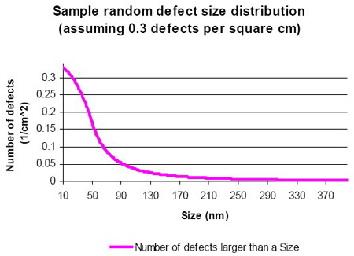
Defect Size Distribution
Sample random defect size
distribution, assuming
0.3 defects per cm²
kx^{–p} for x_{min} < x < x_{max}
0 otherwise
f(x) =
x = Defect diameter
f(x) = Defect density
k = Normalizing constant
p is typically in [2.0, 3.5]
Defect size (nm)
From: http://www.design-reuse.com/articles/10164/model-based-approach-allows-design-for-yield.html
Slide <number>
Notes:
<number>

Slide 18
1.4 The Bathtub Curve
Many components fail early on because of residual or latent defects
Components may also wear out due to aging (less so for electronics)
In between the two high-mortality regions lies the useful life period
Primarily due to latent defects
Failure rate
Infant mortality
Useful life
(low, constant failure rate)
End-of-life wearout
Mechanical
Electronic
λ
Time
Slide <number>
Notes:
<number>

Slide 19
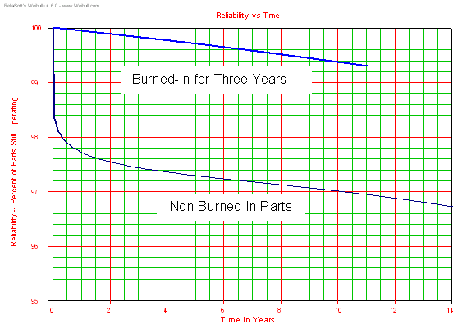
1.5 Burn-in and Stress Testing
Burn-in and stress tests are done in accelerated form
Difficult to perform on complex and delicate ICs without damaging good parts
Percent of parts still working
Expensive “ovens” are required
Time in years
From: http://www.weibull.com/hotwire/issue21/hottopics21.htm
Slide <number>
Notes:
<number>
Stress testing may include vibration, impacts, drops, and so on.

Slide 20
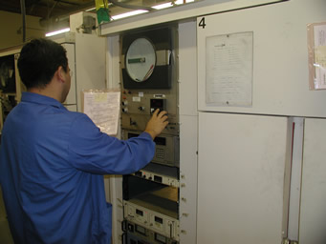
Burn-in Oven Example
From: http://www.goldenaltos.com/environmental_options.html
Slide <number>
Notes:
<number>
There are companies that offer burn-in service for a fee, so there is no need to purchase an expensive burn-in oven for low production volumes.

Slide 21
Old chips are not necessarily unreliable
Data Chips
ECC Chips
Slow, old chips are often cheaper
Employ slow, old chips as a write-only ECC chip.
WRITE-ONLY
…
$
6400MT/s
× 4 (× 9 chips)
3200MT/s
× 4
WRITE-ONLY
$
$
4800MT/s
× 2
and
3200MT/s
× 6
Employ various slow chips to store parity data with buffer support.
…
6400MT/s
× 4 (× 9 chips)
6400MT/s × 4
Notes:
<number>

Slide 22
1.6 Active Defect Prevention
Other than initial or manufacturing imperfections, defects can develop over the course of a device’s lifetime
Defects induced by harsh operating environment
Temperature control
Load redistribution
Clock scaling
Radiation-induced defects
Defects due to shock and vibration
Defects due to mishandling (e.g., scratch or smudge on disk)
. . . discussed in Chap. 7 dealing with shielding and hardening
Slide <number>
Notes:
<number>

Slide 23

2 Defect Circumvention
Slide <number>
Notes:
<number>

Slide 24
Defect Avoidance vs. Circumvention
Defect Avoidance
Defect awareness in design, particularly floorplanning and routing
Extensive quality control during the manufacturing process
Comprehensive screening, including burn-in and stress tests
Defect Circumvention (Removal)
Built-in dynamic redundancy on the die or wafer
Identification of defective parts (visual inspection, testing, association)
Bypassing or reconfiguration via embedded switches
Defect Circumvention (Masking)
Built-in static redundancy on the die or wafer
Identification of defective parts (external test or self-test)
Adjustment or tuning of redundant structures
Slide <number>
Notes:
<number>

Slide 25
2.1 Defective Memory Arrays
Defect circumvention (removal)
Provide several extra (spare) rows and/or columns
Route external connections to defect-free rows and columns
Defect circumvention (masking)
Error-correcting code
Methods in use since the 1970s;
e.g., IBM’s defect-tolerant chip
Peripheral reconfiguration elements
With m rows and s spares,
can model as m-out-of-(m + s)
Somewhat more complex with both spare rows and columns
(still combinational, though)
Spare rows
Spare rows
Memory
array
Memory
array
Defective
column
Defective row
Spare columns
Spare columns
Modeling with coded scheme has been discussed in prior lectures
Slide <number>
Notes:
<number>

Slide 26
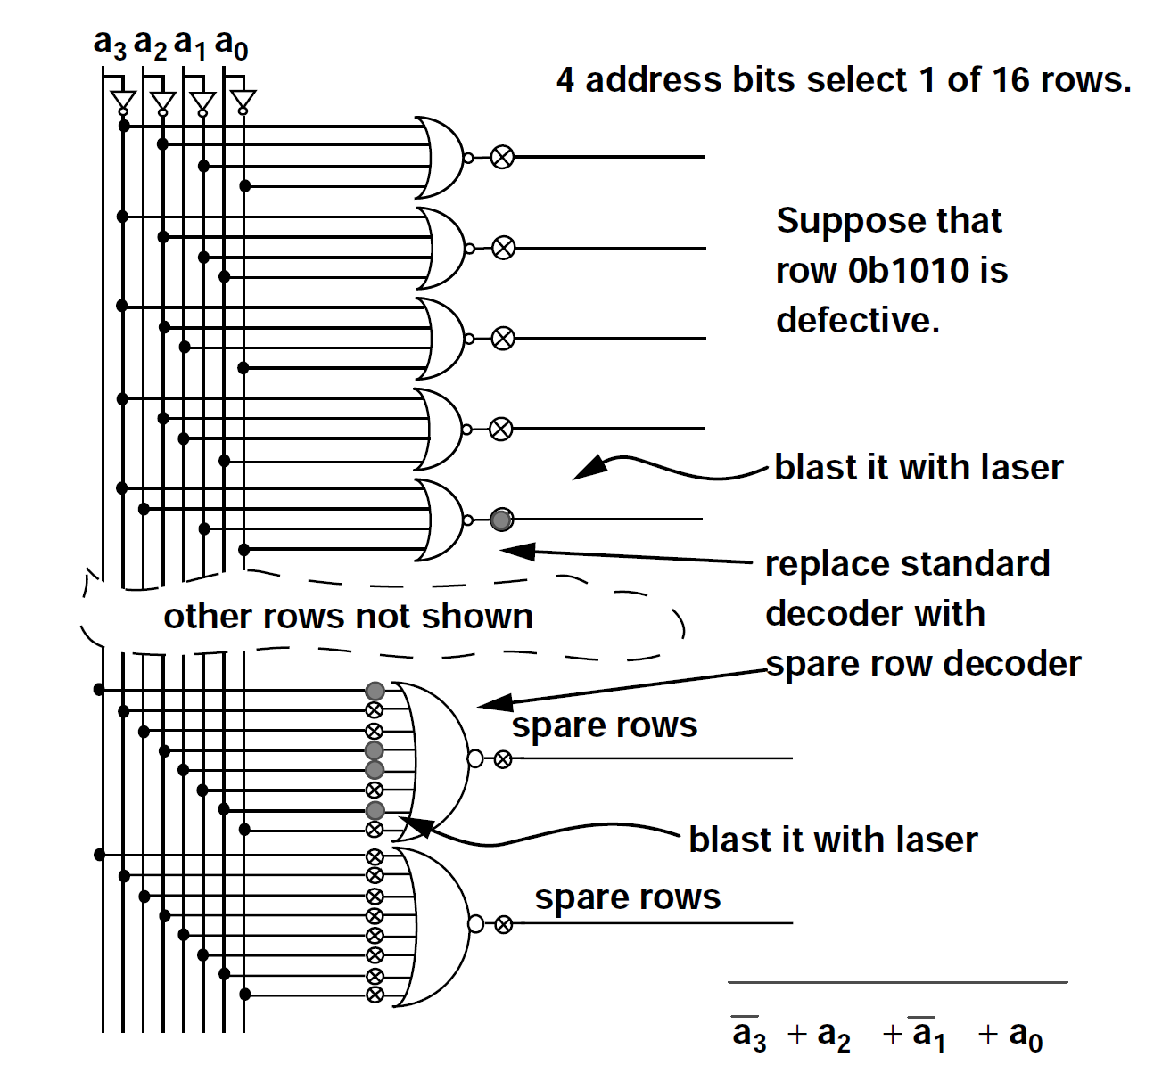
Standard and spare decoder design
Slide <number>

Slide 27
2.2 Defective 1D and 2D Arrays
Multiple resources on a chip not a challenge if they are independent in logic and I/O connections
Example: To build an MPP out of 64-processor chips, one might place 72 processors on each chip to allow for up to 8 defective processors
Given the probability of a processor (including its external connections) being defective, the chip yield can be modeled as a 64-out-of-72 system
In practice, we interconnect such processors on the chip to allow
higher-bandwidth interprocessor communication and I/O
Slide <number>

Slide 28
Defect Circumvention in Regular Arrays
Extensive research done on how to salvage a working array from one that has been damaged by defects
Proposed methods differ in
● Types and placement of switches
(e.g., 4-port, single/double-track)
● Types and placement of spares
● Algorithms for determining working
configurations
● Ways of effecting reconfiguration
● Methods of assessing resilience
The next few slides show some methods
based on 4-port, 2-state switches
Slide <number>

Slide 29
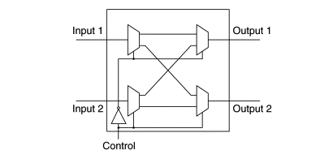
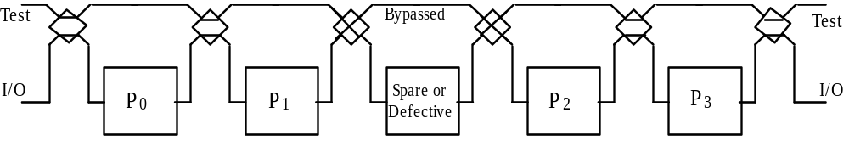
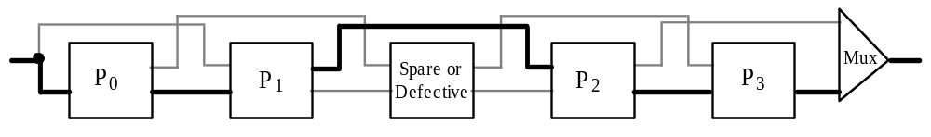
Defect Circumvention in Linear Arrays
Using 4-port, 2-state switches
A linear array with a spare processor and reconfiguration switches
A linear array with a spare processor and embedded switching
Slide <number>
Notes:
<number>
This and the next few slides are based on Introduction to Parallel Processing: Algorithms and Architectures, by B. Parhami, Plenum Press, 1999.
The scheme shown at the top can be made tolerant to defects in switches and associated interconnects via the provision of two rows of switching elements.

Slide 30
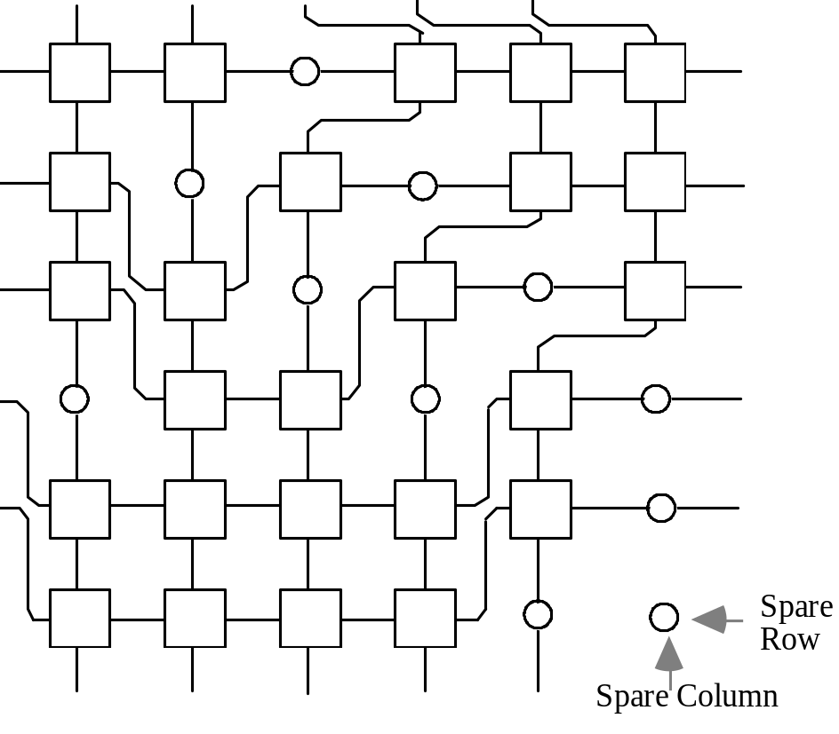
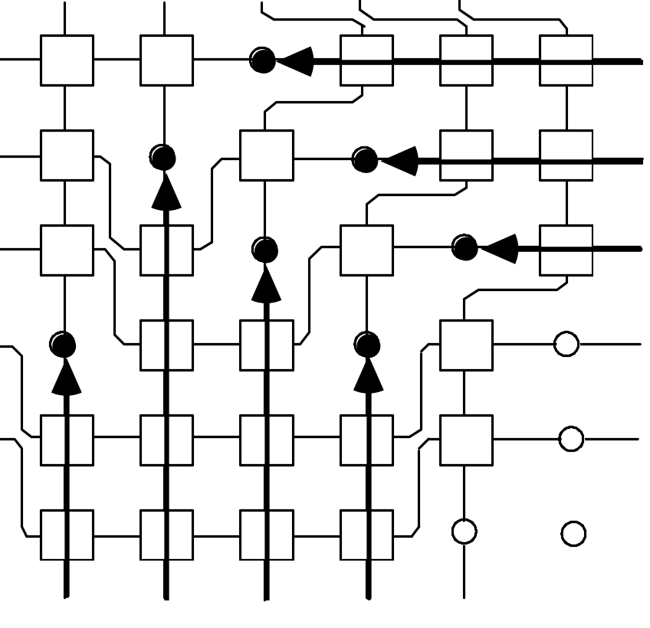
A Reconfiguration Scheme for 2D Arrays
A 5 × 5 working array salvaged from a 6 × 6 redundant mesh through reconfiguration switching
Seven defective processors
in a 5 × 5 array and their associated compensation paths
Slide <number>

Slide 31
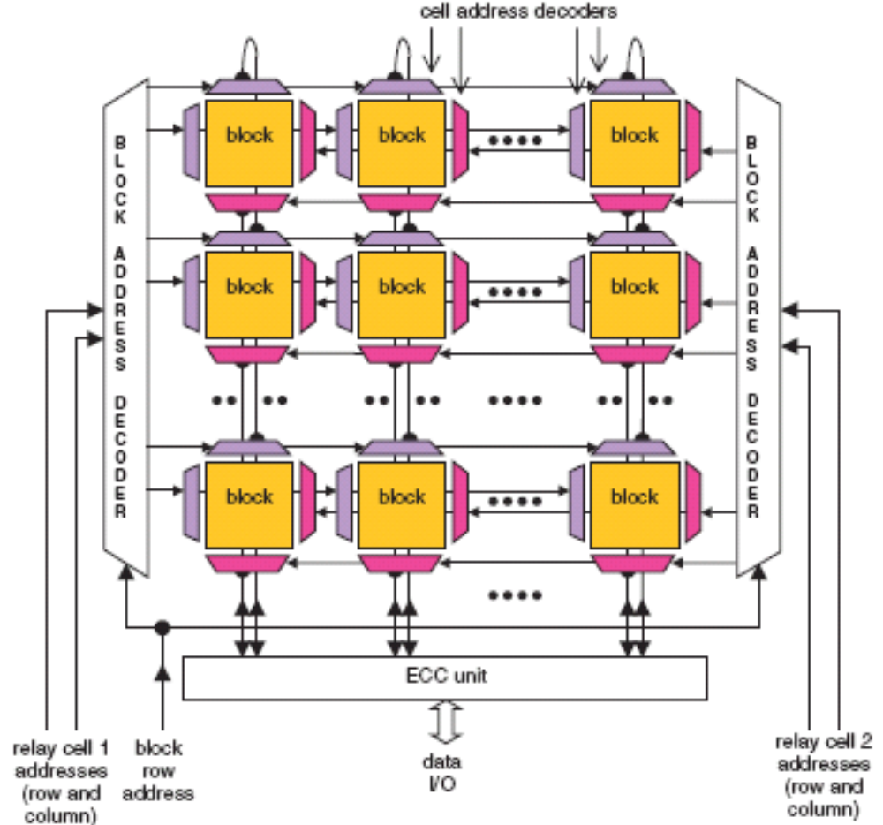
Highly Redundant Nanoelectronic Memories
Memory with
block-level redundancy:
Based on hybrid semiconductor/nanodevice
implementation
Error-correcting code applied for defect tolerance, as opposed to operational or “soft” errors
Image source: Strukov/Likharev, Nanotechnology, Jan. 2005
Slide <number>
Notes:
<number>

